Slide 1




Introduction to Programming
FEU – EAST ASIA COLLEGE
Information Technology Department

Slide 2
Program Development Cycle
1. Analyze: Define the problem
2. Design: Plan the solution to the problem
3. Choose the Interface: Select the objects
4. Code: Translate the algorithm into a programming language.
5. Debug and Test: Locate and remove any errors in the program.
6. Complete the Documentation: Organize all the materials that describe the program.

Slide 3
Algorithm
A set of rules that precisely defines a sequence of operations.
Any set of detailed instructions which results in a predictable
end-state from a known beginning.
Implementation
Most algorithms are intended to be implemented as computer programs. However, algorithms are also implemented by other means, such as in a biological neural network (for example, the human brain implementing arithmetic or an insect looking for food), in an electrical circuit, or in a mechanical device.

Slide 4
Expressing Algorithms
Algorithms can be expressed in many kinds of notation, including:
Natural Languages
Pseudocode
Flowcharts
Programming Languages

Slide 5
Pseudocode
A program design technique that uses English words.
Has no formal syntactical rules.
Pseudo means false, thus pseudocode means false code. It looks like (imitates) real code but it is NOT real code.
Pseudocode cannot be compiled nor executed, and there are no real formatting or syntax rules.
Pseudocode should not include keywords in any specific computer languages.
The benefit of pseudocode is that it enables the programmer to concentrate on the algorithms without worrying about all the syntactic details of a particular programming language.

Slide 6
How do I write Pseudocode?
First you may want to make a list of the main tasks that must
be accomplished on a piece of scratch paper.
Then, focus on each of those tasks. Generally, you should try
to break each main task down into very small tasks that can
each be explained with a short phrase.
There may eventually be a one-to-one correlation between
the lines of pseudocode and the lines of the code that you
write after you have finished pseudocoding.

Slide 7
It is not necessary in pseudocode to mention the need to
declare variables. It is wise however to show the initialization
of variables.
All statements showing "dependency" are to be indented.
These include while, do, for, if, switch.
Some Keywords That Should be Used
For looping and selection, the keywords that are to be used include:
Do While...EndDo Call ... with (parameters)
Do Until...Enddo Call
Case...EndCase Return
If...Endif When

Slide 8
As verbs, use the words:
Generate, Compute, Process
Set, Reset, Increment, Compute, Test
Calculate, Add, Sum, Multiply, ...
Print, Display, Input, Output, Edit

Slide 9
Pseudocode Examples
Original Program Specification:
Write a program that obtains two integer numbers from the user. It will print out the sum of those numbers.
Pseudocode:
Prompt the user to enter the first integer Prompt the user to enter a second integer Compute the sum of the two user inputs Display an output prompt that explains the answer as the sum Display the result

Slide 10
Original Program Specification:
Write a program that will display if the entered student’s grade is passed of failed. Passing grade is 70.
Pseudocode:
Prompt the user to enter a student grade
If student's grade is greater than or equal to 70
Print "passed"
else
Print "failed"

Slide 11
Original Program Specification:
Write a program that will allow the student to input the grade on his 5 subjects and will compute for his average grade.
Original Program Specification:
Set total to zero
Set grade counter to one
While grade counter is less than or equal to 5
Input the next grade
Add the grade into the total
Set the class average to the total divided by 5
Print the class average.

Slide 12
Pseudocode example : If then Else
If age > 17
Display a message indicating you can vote.
Else
Display a message indicating you can't vote.
Endif
Pseudocode example : Case
Case of age
0 to 17 Display "You can't vote."
18 to 64 Display "Your in your working years."
65 + Display "You should be retired."
Endcase

Slide 13
Pseudocode example : While loop
count assigned zero
While count < 5
Display "I love computers!"
Increment count
Endwhile
Pseudocode example : For loop
For x starts at 0, x < 5, increment x
Display "Are we having fun?"
Endfor

Slide 14
Pseudocode example : Do While loop
count assigned five
Do
Display "Blast off is soon!"
Decrement count
While count > zero
Pseudocode example : Repeat Until loop
count assigned five
Repeat
Display "Blast off is soon!"
Decrement count
Until count < one

Slide 15
Pseudocode example : Function with no parameter passing
Function clear monitor
Pass In: nothing
Direct the operating system to clear the monitor Pass Out: nothing
Endfunction
Pseudocode example : Function with parameter passing
Function delay program so you can see the monitor
Pass In: integer representing tenths of a second Using the operating system delay the program
Pass Out: nothing
Endfunction

Slide 16
Pseudocode of : Function main calling the clear monitor function
Function main
Pass In: nothing
Doing some lines of code
Call: clear monitor
Doing some lines of code
Pass Out: value zero to the operating system Endfunction

Slide 17
Flowchart
The flowchart is a means of visually presenting the flow of data through an information processing systems, the operations performed within the system and the sequence in which they are performed.
In our lesson, we shall concern ourselves with the program flowchart, which describes what operations (and in what sequence) are required to solve a given problem.
The program flowchart can be likened to the blueprint of a building. As we know a designer draws a blueprint before starting construction on a building. Similarly, a programmer prefers to draw a flowchart prior to writing a computer program. As in the case of the drawing of a blueprint, the flowchart is drawn according to defined rules and using standard flowchart symbols prescribed by the American National Standard Institute, Inc. (ANSI)

Slide 18
Meaning of Flowchart
A flowchart is a diagrammatic representation that illustrates the sequence of operations to be performed to get the solution of a problem.
Logic diagram to describe each step that the program must perform to arrive at the solution.
A popular logic tool used for showing an algorithm in graphics form.
Flowcharting software examples : microsoft visio, flowbreeze, RFFlow, SmartDraw

Slide 19
Types of Flowcharts
Document Flowchart
Data Flowchart
System Flowchart
Program Flowchart

Slide 20

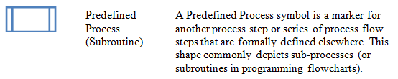

Flowcharting Symbols

Slide 21





Slide 22
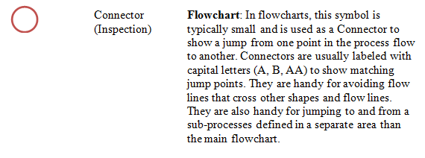
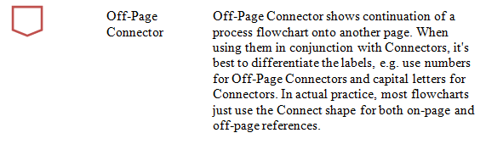

Slide 23
Guidelines for Drawing a Flowchart
In drawing a proper flowchart, all necessary requirements
should be listed out in logical order.
The flowchart should be clear, neat and easy to follow. There
should not be any room for ambiguity in understanding the
flowchart.
The usual direction of the flow of a procedure or system is
from left to right or top to bottom.

Slide 24


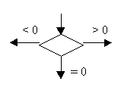
Only one flow line should come out from a process symbol.
Only one flow line should enter a decision symbol, but two or
three flow lines, one for each possible answer, should leave the
decision symbol.

Slide 25



Only one flow line is used in conjunction with terminal symbol.
Write within standard symbols briefly. As necessary, you can
use the annotation symbol to describe data or
computational steps more clearly.

Slide 26
If the flowchart becomes complex, it is better to use
connector symbols to reduce the number of flow lines.
Avoid the intersection of flow lines if you want to make it
more effective and better way of communication.
Ensure that the flowchart has a logical start and finish.
It is useful to test the validity of the flowchart by passing
through it with a simple test data.

Slide 27
ADVANTAGES OF USING FLOWCHARTS
The benefits of flowcharts are as follows:
Communication: Flowcharts are better way of communicating
the logic of a system to all concerned.
Effective analysis: With the help of flowchart, problem can be
analyzed in more effective way.
Proper documentation: Program flowcharts serve as a good
program documentation, which is needed for various purposes.

Slide 28
Efficient Coding: The flowcharts act as a guide or blueprint
during the systems analysis and program development phase.
Proper Debugging: The flowchart helps in debugging process.
Efficient Program Maintenance: The maintenance of operating
program becomes easy with the help of flowchart. It helps the
programmer to put efforts more efficiently on that part

Slide 29
LIMITATIONS OF USING FLOWCHARTS
Complex logic: Sometimes, the program logic is quite
complicated. In that case, flowchart becomes complex and
clumsy.
Alterations and Modifications: If alterations are required the
flowchart may require re-drawing completely.
Reproduction: As the flowchart symbols cannot be typed,
reproduction of flowchart becomes a problem.

Slide 30
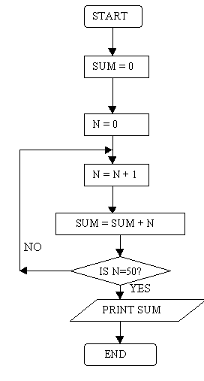
Flowcharting Examples
Example 1
Draw a flowchart to find the sum of first 50 natural numbers.

Slide 31
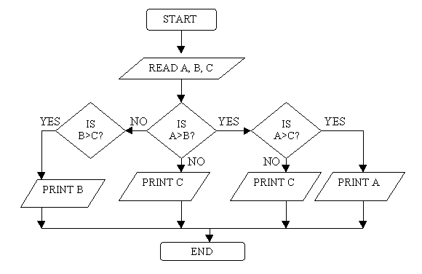
Example 2
Draw a flowchart to find the largest of three numbers A,B, and C.

Slide 32
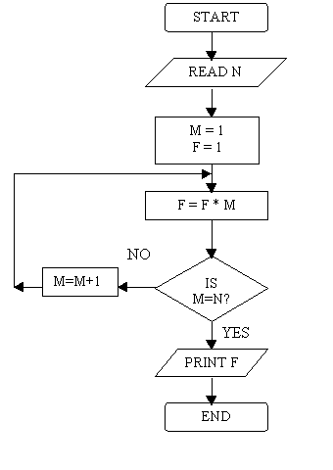
Example 3
Draw a flowchart for computing factorial N (N!)
Where N! = 1 ´ 2 ´ 3 ´ …… N .

